Slide 1
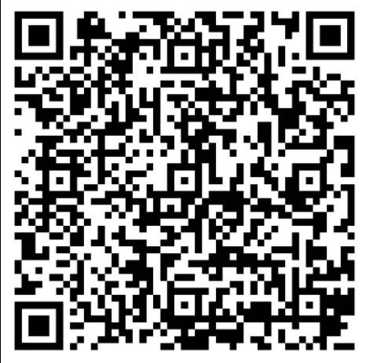
Our 4th Grade Classroom News
The Week of 10/19/20
Mrs. Carson: lcarson@Paulding.k12.ga.us Mrs. King: stking@Paulding.k12.ga.us Mrs. Walton: rwalton@paulding.k12.ga.us
Mrs. Chapman jtallman@Paulding.k12.ga.us
Mrs. Mittelman: b mittelman@paulding.k12.ga.us Mrs. Yergin: ayergin@paulding.k12.ga.us
Reading/Writing
RI1:Refer to details and examples in a text when explaining what the text says explicitly and when drawing inferences from the text.
RI3:Explain events, procedures, ideas, or concepts in a historical, scientific, or technical text, including what happened and why, based on specific information in the text
RI5:Describe the overall structure of events, ideas, concepts, or information in a text or part of a text.
RI7: Interpret information presented visually, orally, or quantitatively and explain how the information contributes to an understanding of the text in which it appear
RI8:Explain how an author uses reasons and evidence to support particular points in a text
Narrative Writing
W3: Write narratives to develop real or imagined experiences or events using effective technique, descriptive details, and clear event sequences.
Reminders
October
Now-25th : sign up for virtual learning – if you want your child to do virtual for second semester.
26th - 30th - Red Ribbon Week-(activities coming soon)
Due to Covid guidelines, no cupcakes are allowed for birthday celebrations. Our amazing Cafe’ staff is now selling treats for birthdays. Scan QR code to order treats
Math and Science
NBT5- Multiply multi digit numbers (1x4 digit, 2x2 digit) using place value, properties of multiplication, equations, area models, and/or arrays.
Science
E2. Obtain, evaluate, and communicate information to model the effects of the position and motion of the Earth and the moon in relation to the sun as observed from the Earth
Specials Rotations
 | Mon | Tues | Wed | Thu | Fri | Mon
Carson | Music E | PE | Media | Art | Music J | Music E
Chapman | Music J | Music E | PE | Media | Art | PE
King | Media | Art | Music J | Music E | PE | Music J
Walton | PE | Media | Art | Music J | Music E | STEM
At-Home Practice
Notes:
https://paulding.revtrak.net/.https://youtu.be/Wi0lCJHAeys

Slide 2
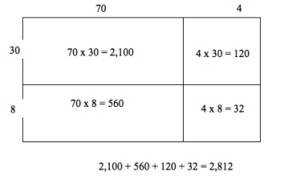
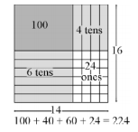
How we teach Multiplication
Array/Area Model
The area model below shows the partial products for 14 x 16 = 224. Using the area model, students first verbalize their understanding:
• 10 x 10 is 100
• 4 x 10 is 40
• 10 x 6 is 60, and
• 4 x 6 is 24.
What would an array area model of 74 x 38 look like?
Distributive Property
(decomposing larger number)
To illustrate 154 x 6, students use base 10 blocks or use drawings to show 154 six times. Seeing 154 six times will lead them to understand the distributive property
Multiplication Videos
https://www.youtube.com/watch?reload=9&v=MVZRD4Fa1OY
https://www.youtube.com/watch?v=WYJsQo7ZTC4

